Slide 1
Descriptive epidemiology

Slide 2
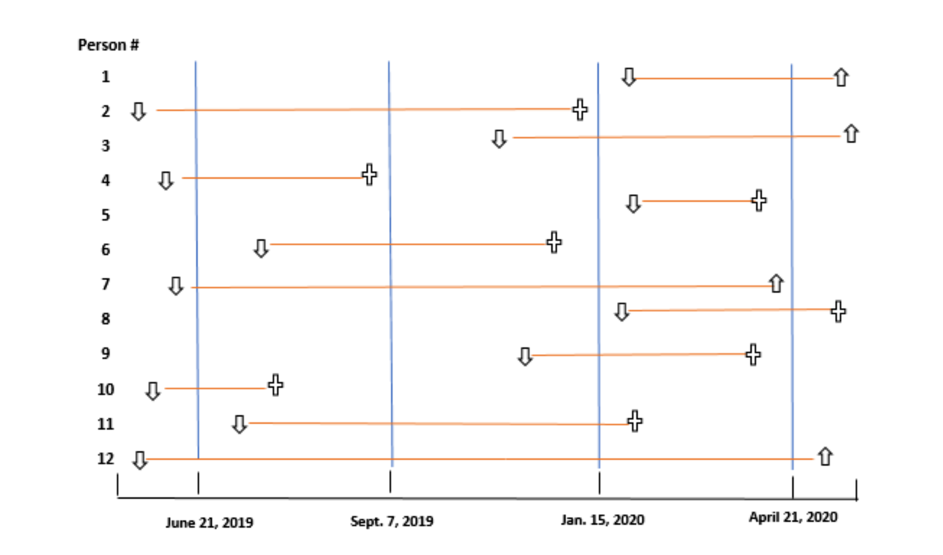

Slide 3
MCQ - 1
Which is true about DALY?
Life is adjusted for disease
Premature death is adjusted for disability
Life expectancy free of disability
Years lost to premature death and years lived with disability adjusted for severity of disability

Slide 4
MCQ - 2
Which is the best index for burden of disease?
Case Fatality Rate
Disability adjusted life years
Dependency Ratio
Morbidity data

Slide 5
MCQ - 3
A party was attended by 110 people. Out of which 40 did not eat fruit salad. From the rest who ate fruit salad,55 developed food poisoning. What is the Attack Rate?
50
78
56
46

Slide 6
MCQ - 4
In population of 5000,number of new cases of TB is 500,old cases in same population are 150.What is the prevalence of TB?
9%
12%
13%
18%

Slide 7
MCQ - 5
5. Which of the following study design has population as unit of study
a. Case - control
b. Cohort
c. Cross - sectional
d. Ecological study

Slide 8
Steps
1. Defining the population to be studied
2. Defining the disease under study
3. Describing the disease by
a. time
b. place
c. person
4. Measurement of disease
5. Comparing with known indices
6. Formulation of an aetiological hypothesis

Slide 9
Time Distribution
The pattern of disease may be described by the time of its occurrence, i.e., by week, month, year, the day of the week, hour of onset, etc.
It raises questions whether the disease is seasonal in occurrence; whether it shows periodic increase or decrease; or whether it follows a consistent time trend.
Such studies may yield important clues about the source or aetiology of the disease, thereby suggesting potential preventive measures.
Epidemiologists have identified three kinds of time trends or fluctuations in disease occurrence.
Short – term fluctuations
Periodic fluctuations
Long term / Secular trend

Slide 10
Short term fluctuations
The best known short-term fluctuation in the occurrence of a disease is an epidemic.
Common-source epidemics are frequently, but not always, due to exposure to an infectious agent. They can result from contamination of the environment (air, water, food, soil) by industrial chemicals or pollutants,
An epidemic is defined as “the occurrence in a community or region of cases of an illness or other health-related events clearly in excess of normal expectancy”.
Epidemicity is thus relative to usual frequency of the disease in the same area, among the specified population, at the same season of the year

Slide 11
Epidemics
A. Common-source epidemics
(a) Single exposure or “point-source” epidemics.
(b) Continuous or multiple exposure epidemics
B. Propagated epidemics
(a) Person-to-person
(b) Arthropod vector
(c) Animal reservoir
C. Slow (modern) epidemics.

Slide 12
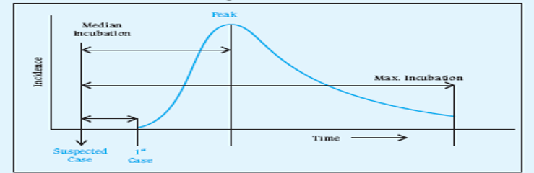
Single exposure / Point source
The epidemic curve rises and falls rapidly, with no secondary waves
The epidemic tends to be explosive, there is clustering of cases within a narrow interval of time,
All the cases develop within one incubation period of disease.

Slide 13
Continuous/ Repeated exposure
Exposure from the same source may be prolonged - continuous, repeated or intermittent – not necessarily at the same time or place.
A FSW may be a common source in a gonorrhoea outbreak, but since she will infect her clients over a period of time there may be no explosive rise in the number of cases.
A well of contaminated water, or a nationally distributed brand of vaccine (e.g. polio vaccine), or food, could result in similar outbreaks.
In these instances, the resulting epidemics tend to be more extended or irregular.
A variation to the above model is that an epidemic may be initiated from a common source and then continue as a propagated epidemic.
Water-borne cholera is a familiar example, the epidemic reaches a sharp peak, but tails off gradually over a longer period of time.

Slide 14
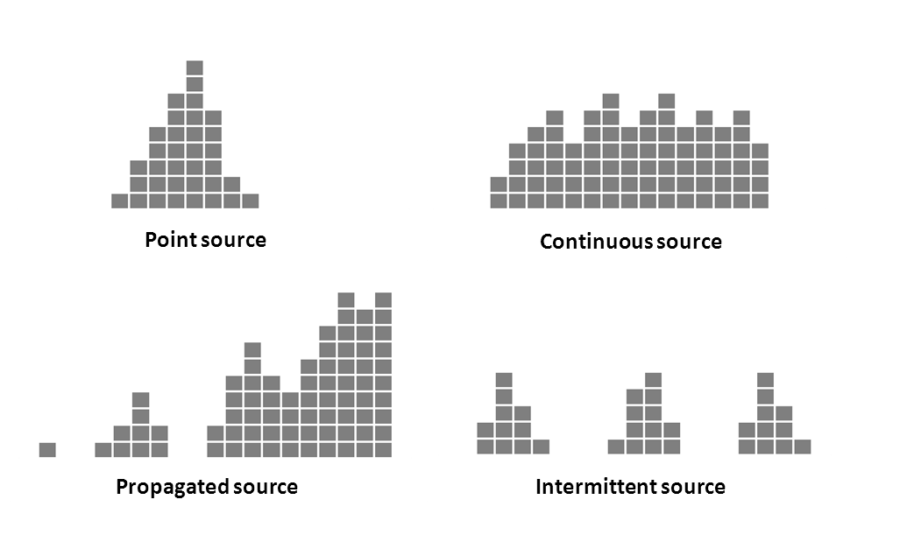
Epidemic Curve

Slide 15

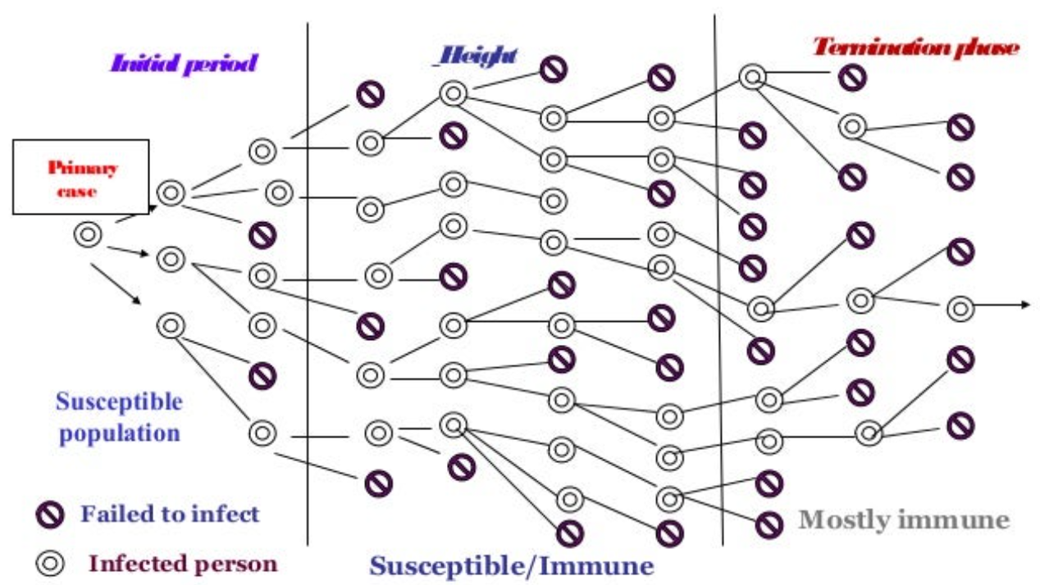
Propagated epidemic
Most often infectious origin – person to person; example – Hep A, Polio
The epidemic usually shows a gradual rise and tails off a much longer period of time.
Until number of susceptible is depleted or no longer exposed to infected person / intermediary vector.
Speed of spread depends on herd immunity, opportunities for contact and SAR
More likely - regular supply of new susceptible individuals (birth, immigrants)
Large number of susceptible are aggregated

Slide 16
Herd Immunity
Resistance of group of people to an attack by disease to which a large proportion of group is immune.
Conditions to be met :-
Restricted to single host species
Relatively direct transmission
Must induce solid immunity
Probability of infected person encountering every other individual is same
Population are constantly mixing
Degree to which herd immunity is achieved depends on extent to which randomly mixing of population occurs

Slide 17
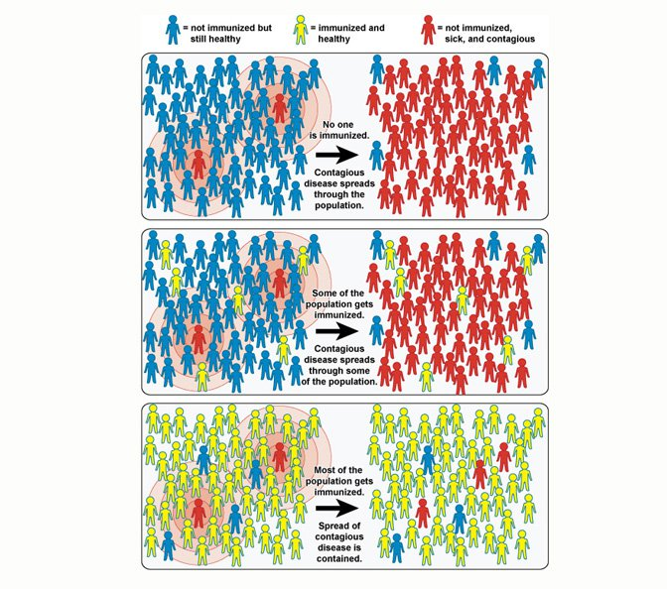

Slide 18
Slow (Modern) epidemics
Non – Communicable disease
Due to lifestyle changes

Slide 19
Periodic fluctuations
Seasonal Trend
Cyclical Trend
Measles, Varicella, URTI, Malaria, Dengue
Early spring – Measles, Varicella
Winter – URTI
Summer – GI, sunstroke
Environmental conditions
Days, Weeks, months or years
Measles – pre vaccination era ( every 2 to 3 years)
Influenza – 7 – 10 years (antigenic variations)
RTA in US weekends

Slide 20
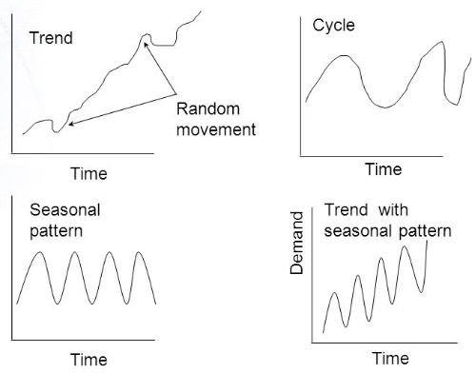

Slide 21
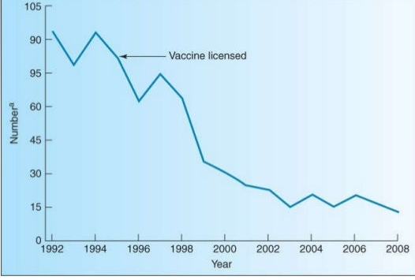
Long term / secular trends
The term “secular trend’ implies changes in the occurrence of disease (i.e. a progressive Increase or decrease) over a long period of lime, generally several years or decades.
It may have short-term fluctuations imposed on it, a secular trend Implies a consistent tendency to change in a particular direction or a definite movement in one direction.
Examples include coronary heart disease, lung cancer and diabetes which have shown a consistent upward trend in the developed countries during the past 50 years or so, followed by a decline of such diseases as tuberculosis, typhoid fever, diphtheria and polio.

Slide 22
Interpretation
Which diseases are Increasing, which decreasing, and which are the emerging health problems and of the effectiveness of measures to control old ones.
He tries to formulate aetiological hypotheses and seeks explanations whether these changes were due to changes in the aetiological agent or variations in diagnosis, reporting, case fatality or changes in age distribution, or some other determinants, specific and non-specific (e.g., changes in quality of life, socio-economic status and personal habits).
Example
The “time-clustering” of cases of adenocarcinoma of vagina in young women led to the incrimination of its cause, viz. in utero exposure to diethylstilbestrol.

Slide 23
Place distribution
Studies of the geography of disease (or geographical pathology) is one of the important dimensions of descriptive epidemiology.
Perspective on the fascinating differences (or variations) in disease patterns not only between countries, but also within countries.
The relative importance of genes versus environment;
Changes with migration
Possible roles of diet
Geographic patterns provide an important source of clues about the causes of the disease.
The range of geographic studies include those concerned with local variations. At a broader level, international comparisons may examine mortality and morbidity in relation to socio-economic factors, dietary differences and the differences in culture and behaviour. These variations may be classified as :
International variations
National variations
Rural Urban Variation
Local distributions

Slide 24
International variations
Pattern of disease is not the same everywhere.
Marked difference between the incidence of each cancer in different parts of the world.
Cancer of the stomach is very common in Japan, but unusual in US.
Cancers of the oral cavity and uterine cervix are exceedingly common in India as compared to industrialized countries.
An International study of breast cancer showed that rates differ widely from country to country with the lowest prevalence in Japan and the highest in the western countries.
Similarly, there are marked international differences in the occurrence of cardiovascular diseases.
These variations have stimulated epidemiologists to search for cause-effect relationships between the environmental factors and disease.

Slide 25
National Variations
The distribution of endemic goitre, lathyrism, fluorosis, leprosy, malaria, nutritional deficiency diseases have all shown variations in their distribution in India, with some parts of the country more affected and others less affected or not affected at all.
Such situations exist in every country.
Such information is needed to demarcate the affected areas and for providing appropriate health care services.

Slide 26
Rural Urban Variations
Chronic bronchitis, accidents, lung cancer, cardiovascular diseases, mental illness and drug dependance are usually more frequent in urban than in rural areas.
On the other hand, skin and zoonotic diseases and soil-transmitted helminths may be more frequent in rural areas than in urban areas.
Death rates, especially infant and maternal mortality rates, are higher for rural than urban areas.
These variations may be due to differences in population density, social class, deficiencies in medical care, levels of sanitation, education and environmental factors.
The epidemiologist seeks to define groups which are at higher risk for particular diseases and provides guidelines to the health administrator for their prevention and control.

